Slide 1



My Portfolio Website
Hello everyone, my name is Umair Khalid. Today, I'm going to explain the code behind my portfolio website.
by Ch Umair

Slide 2

HTML Structure
Here's the basic structure of my HTML file. I used semantic HTML elements for better readability and accessibility.
1
DOCTYPE
2
HTML
Defines the document type.
Sets the language of the document.
3
HEAD
4
BODY
Contains meta information and links to CSS files.
Contains the content of the website.

Slide 3
Header Section
The header includes the navigation menu and hero section.
Header
Navigation
Hero Section
Contains the navigation and hero section.
Uses utility classes for layout. Includes the logo and navigation links.
Contains the introductory image and text.

Slide 4
About Me Section
The About Me section provides information about my background.
About Section
Container
Defines the About Me like my education journey.
Contains the section content.
Image
Education
Displays my image.
Provides details about my education.

Slide 5
Skills Section
The Skills section highlights my core competencies.
Skills Section
Card Wrapper
Skill Cards
Defines the Skills section.
Uses CSS Grid to layout skill cards.
Each card represents a skill with an image and description.

Slide 6
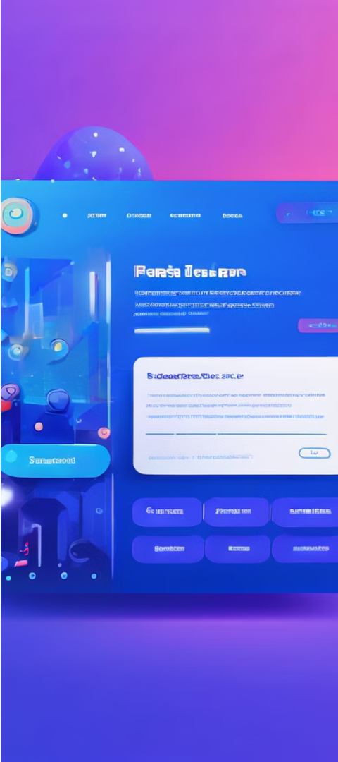
Freelance Section
The Freelance section advertises my availability for projects.
Freelance Section
Background
Defines the Freelance section.
Uses linear-gradient for styling.
Call-to-Action
Styled with CSS.

Slide 7

Reviews Section
The Reviews section features client testimonials.
Reviews Section
Slides
Defines the Reviews section.
Each slide contains an image and testimonial.
1
2
3
Slider
Uses Slick Carousel for sliding reviews.

Slide 8


CSS Structure
I used two CSS files: style.css and utilities.css.
Import
Root
Imports utility classes.
Defines CSS variables for consistent styling.

Slide 9

CSS Styling
Global Styles
Header Styles
The body { ... } rule sets the global font and margin/padding for the website, establishing a consistent look and feel across all pages.
The header { ... } rule styles the header section with a background and clip-path, creating a visually striking and unique design element.
Container Styles
The .container { ... } rule defines a max-width and centering for the main content container, ensuring a clean and balanced layout.

Slide 10
JavaScript Integration
Interactivity
Slick Carousel
External Script
JavaScript adds interactivity to the website, enhancing the user experience and making the site more engaging.
The Slick Carousel library is used to create the dynamic reviews section, allowing users to easily navigate through the testimonials.
The script.js file is linked to the HTML, connecting the JavaScript functionality to the website's structure and content.

Slide 11

Responsive Design
Mobile-First
Fluid Grid
The website is designed with a mobile-first approach, ensuring a seamless user experience on smaller screens.
The use of a fluid grid system allows the content to fluidly adjust and reflow, creating a cohesive and responsive design.
1
2
3
Breakpoints
Carefully placed breakpoints in the CSS adapt the layout and styling to different device sizes, from smartphones to desktops.

Slide 12




Performance Optimization
Image Optimization
Code Minification
Caching
CDN Integration
Caching strategies are implemented to store static assets and reduce the number of server requests.
The website utilizes a Content Delivery Network (CDN) to serve assets from the closest server, improving global load times.
Images are compressed and optimized to reduce file size and improve page load times.
HTML, CSS, and JavaScript files are minified to remove unnecessary whitespace and reduce the overall file size.

Slide 13
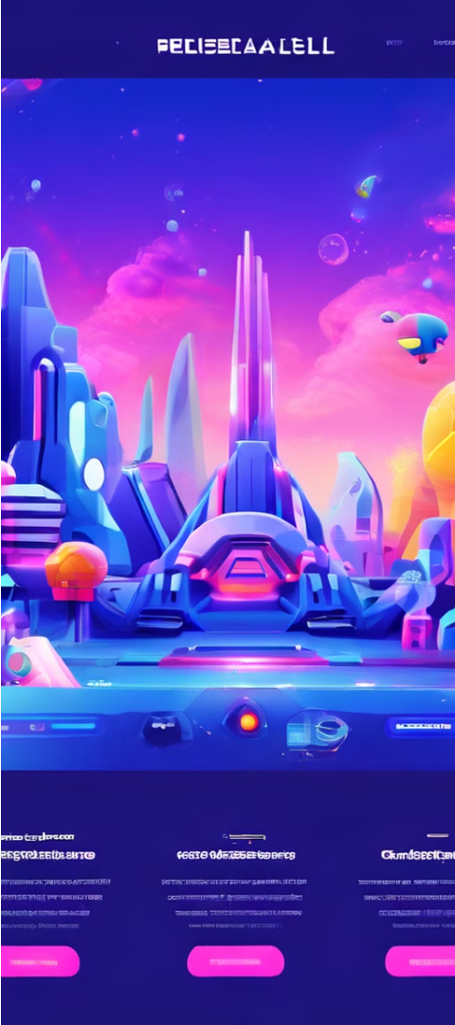
Conclusion
1
Showcase of Skills
2
Attention to Detail
This website demonstrates my expertise in web development, combining HTML, CSS, and JavaScript to create an interactive and visually appealing portfolio.
I have paid close attention to every aspect of the website, from the CSS styling to the JavaScript integration, to ensure a seamless and high-quality user experience.
3
Thank You
Thank you for your time and attention. I'm excited to discuss this project further and answer any questions you may have.

Slide 14
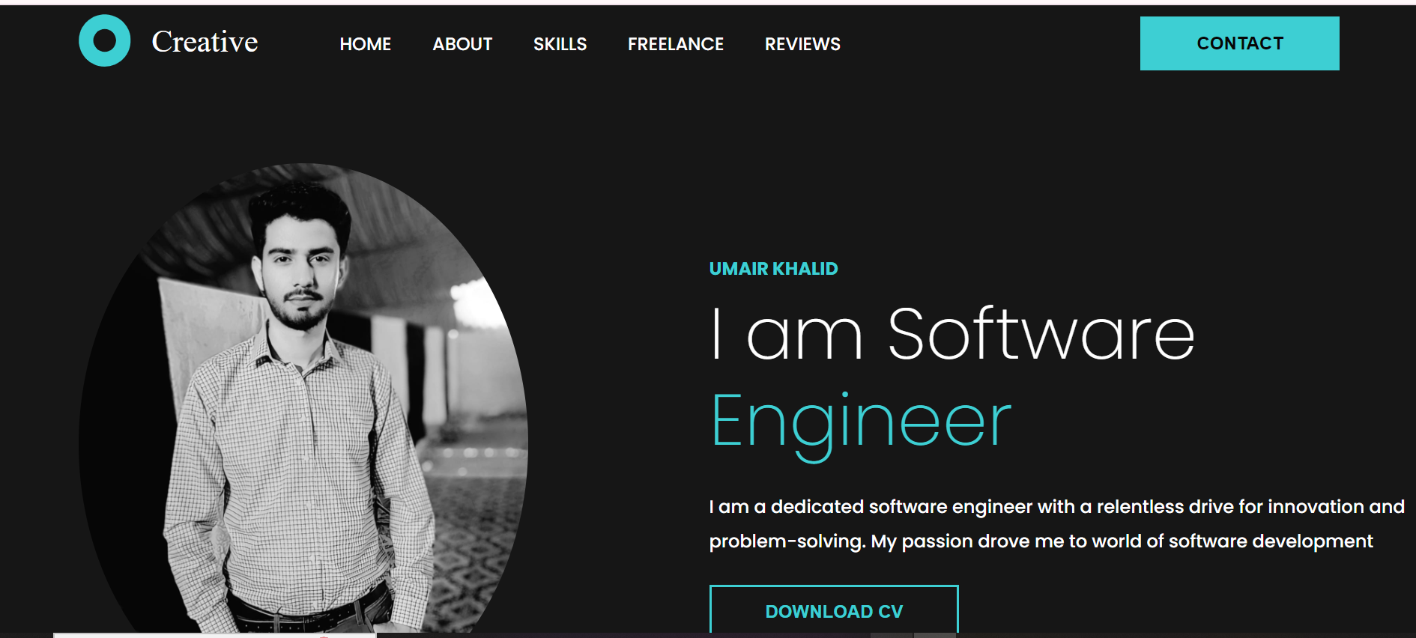
Screenshot of my Website

Slide 15
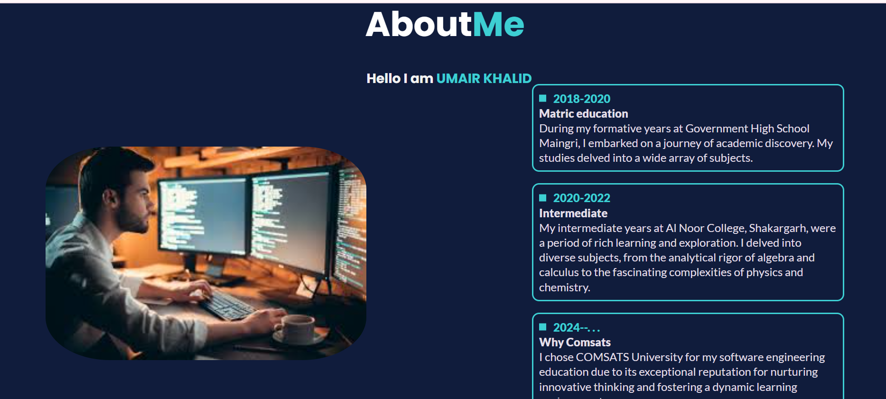
Screenshot of my Website

Slide 16



Questions & Answers
Q&A Session
Feedback
Next Steps
I'm happy to answer any questions you may have about the website or my web design process.
Your feedback is valuable, and I'm eager to learn how I can further improve the website and my overall web design skills.
Let's discuss the next steps and explore how I can contribute to your project and help bring your vision to life.

